Slide 1







HR Analytics
Optimum Effectiveness
Maximum Productivity
Reem Babikir
Divergence Academy
Data Science Cohort #10

Slide 2
What Is The Model’s Main Purpose?
Why Employees Are Leaving?
Predict Which Employees Will leave Next

Slide 3








Work Flow:
Trifacta
Rapid Miner
Microsoft Power BI

Slide 4
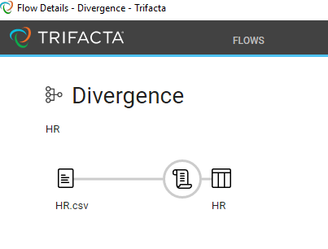
What Did Initial Data Set Look Like?
CSV file
Created new Work Flow in Trifacta
Uploaded raw data
Instant Recipe created
Time to Wrangle!

Slide 5
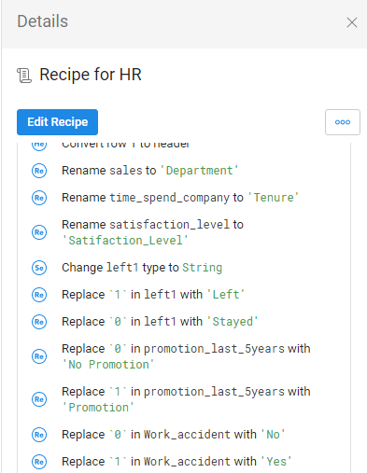
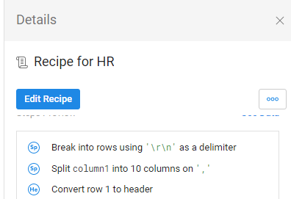
Recipe
Initial Recipe
Added Steps

Slide 6
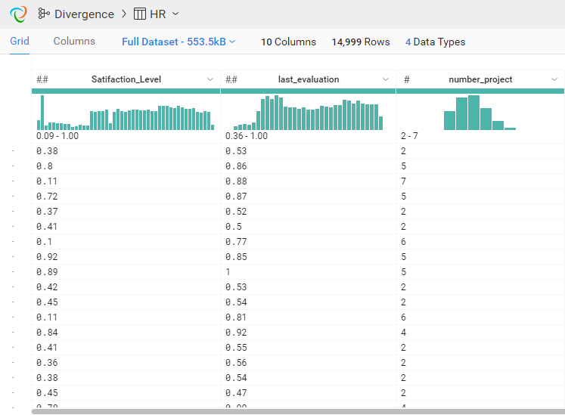
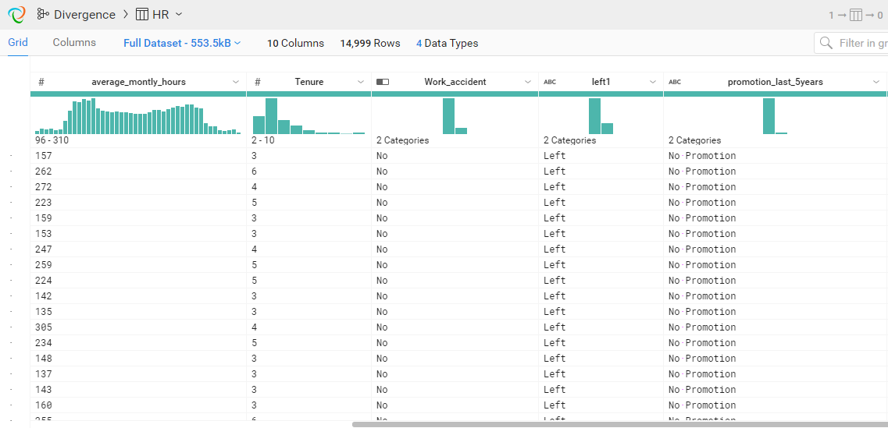
Generated Results

Slide 7
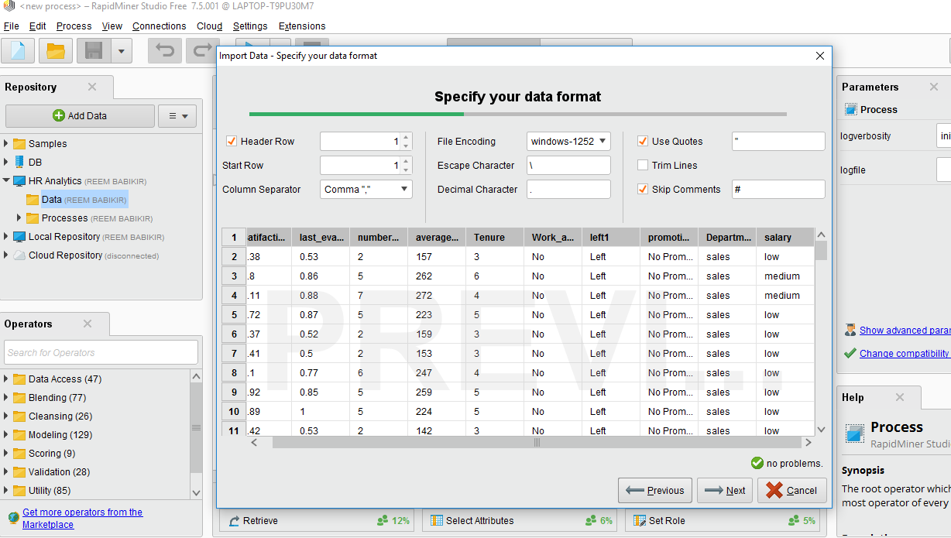
Rapidminer Workflow

Slide 8
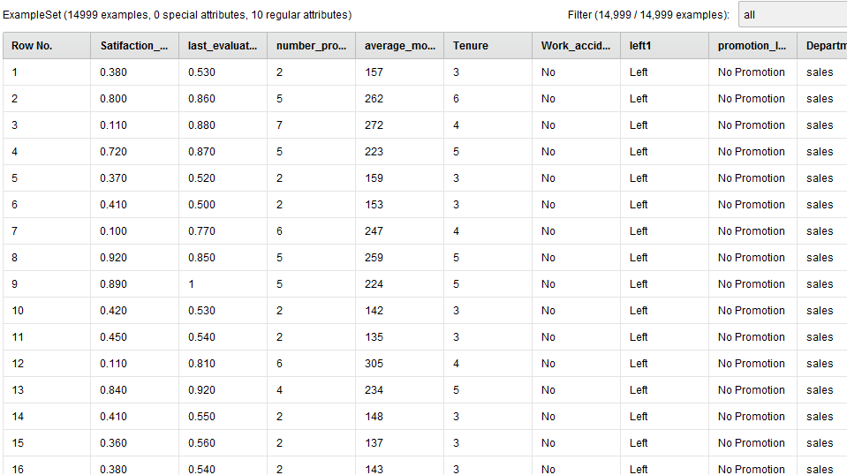
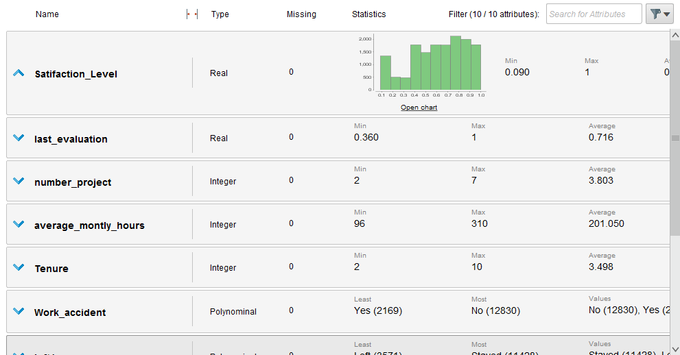
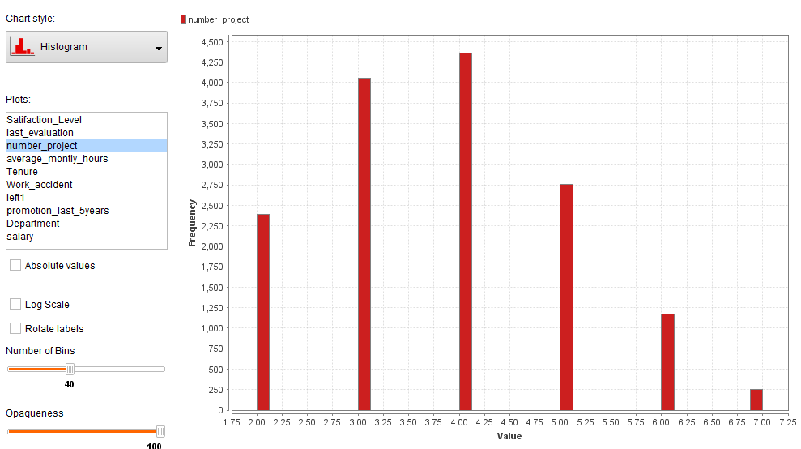
Results After Data Prep
Data
Statistics
Charts

Slide 9
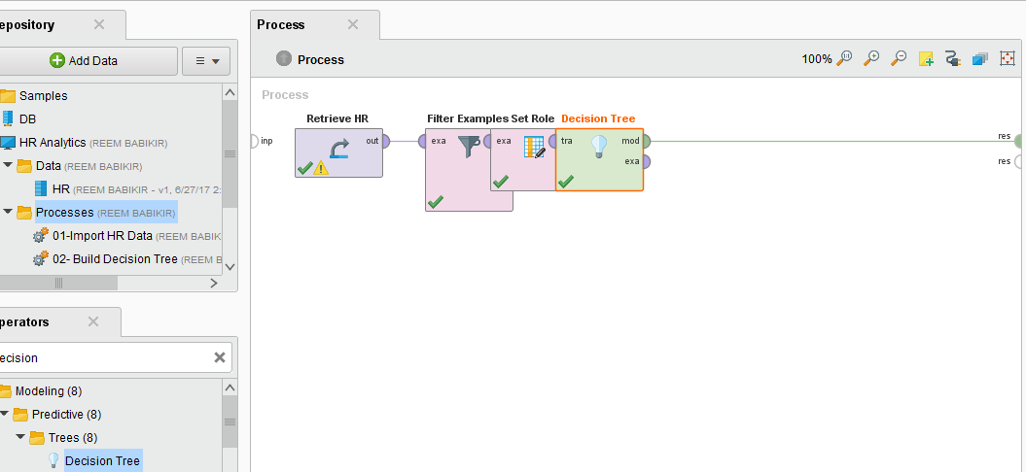
Process & Model Used
ETL built-in operator
Decision Tree model

Slide 10
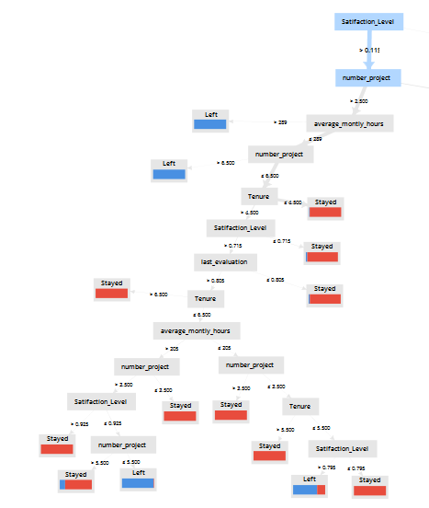
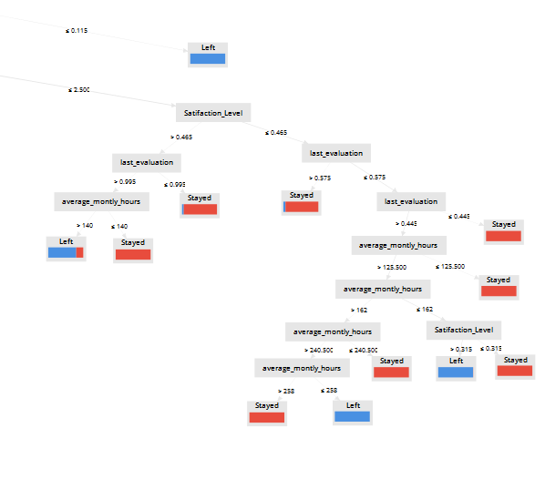
Tree (Decision Tree)

Slide 11
What’s Next?
Apply Model
Predict Which Employees Will Leave Next

Slide 12
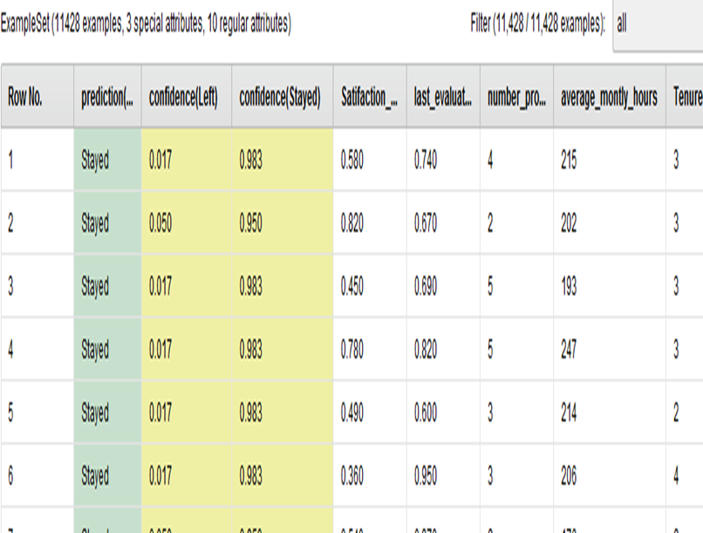
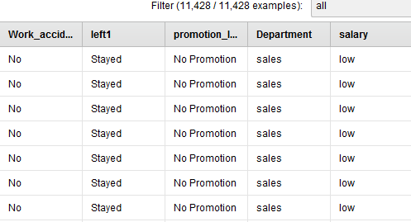
Results of Prediction

Slide 13
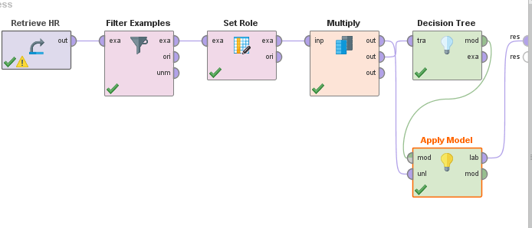
Testing Model Accuracy
Loaded Data
Set Role w/ examples of Stayed or Left
Created Training Data Set
Fed Training Data into Decision Tree
Kept a copy & used it to apply model to create predicted labels
Compare the label columns

Slide 14
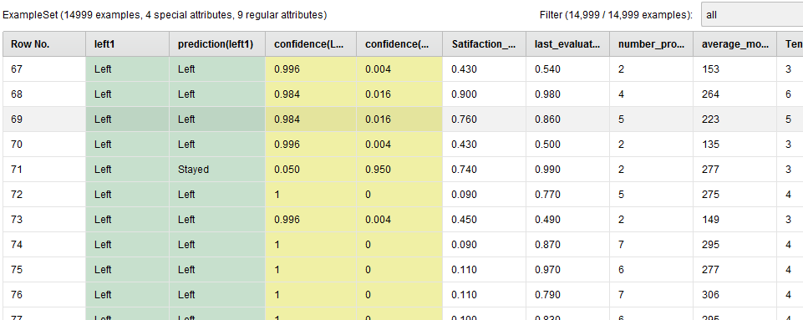
Testing Model Accuracy Results

Slide 15
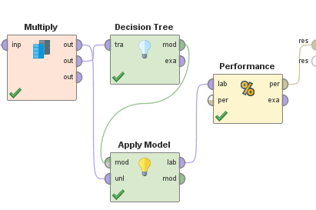
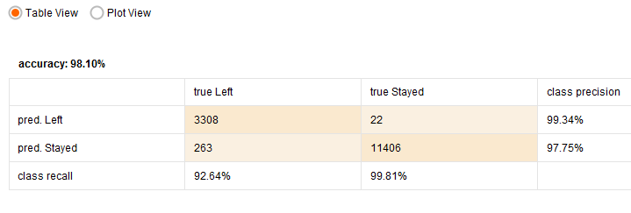
How Did Our Model Perform?
98.10 % Accuracy
Not Too Shabby!

Slide 16
More Work To Be Done
Validate The Model
Use Split Validation or Cross Validation
Cross Validation will break my data into smaller subsets
Will test 1 and then iterate
Build the model, measure performance
Finally, average scores for final accuracy

Slide 17
Eat. Sleep. Wrangle.™

